Slide 1
Money Management Android App For Ease In Trading
SOFTWARE DEVELOPMENT PROJECT
Guided by -
Prof. Jayant Kulkarni
Vivek Chandrashekhar Rugale - C 24 (11810369)

Slide 2
Objective
For a good trade in stock markets, one should be able to manage his money efficiently so that the outcome will be a good profit. Most of the times small profits and large losses can be seen due to bad money management while trading. Objective of this project is to make a mobile application where traders will be able to study the money they are investing in the various stocks. The app will also be able to compute the quantity of a particular stock to be bought depending upon the risk the trader is willing to take.

Slide 3
Need of the project
The app will feature user’s portfolio statistics on home page.
More activities include possible trades, open trades and closed trades where all the basic calculations are done by the app and related information about your trade can be seen.
Using this android app, traders will be able to study the flow of the money they have invested and will be able to take good decisions about next move.

Slide 4
Softwares and tools
Android Studio
https://developer.android.com/training
https://www.youtube.com/

Slide 5
Workflow
Possible Trades
Portfolio stats
Open Trades List
Information
Closed Trades List

Slide 6
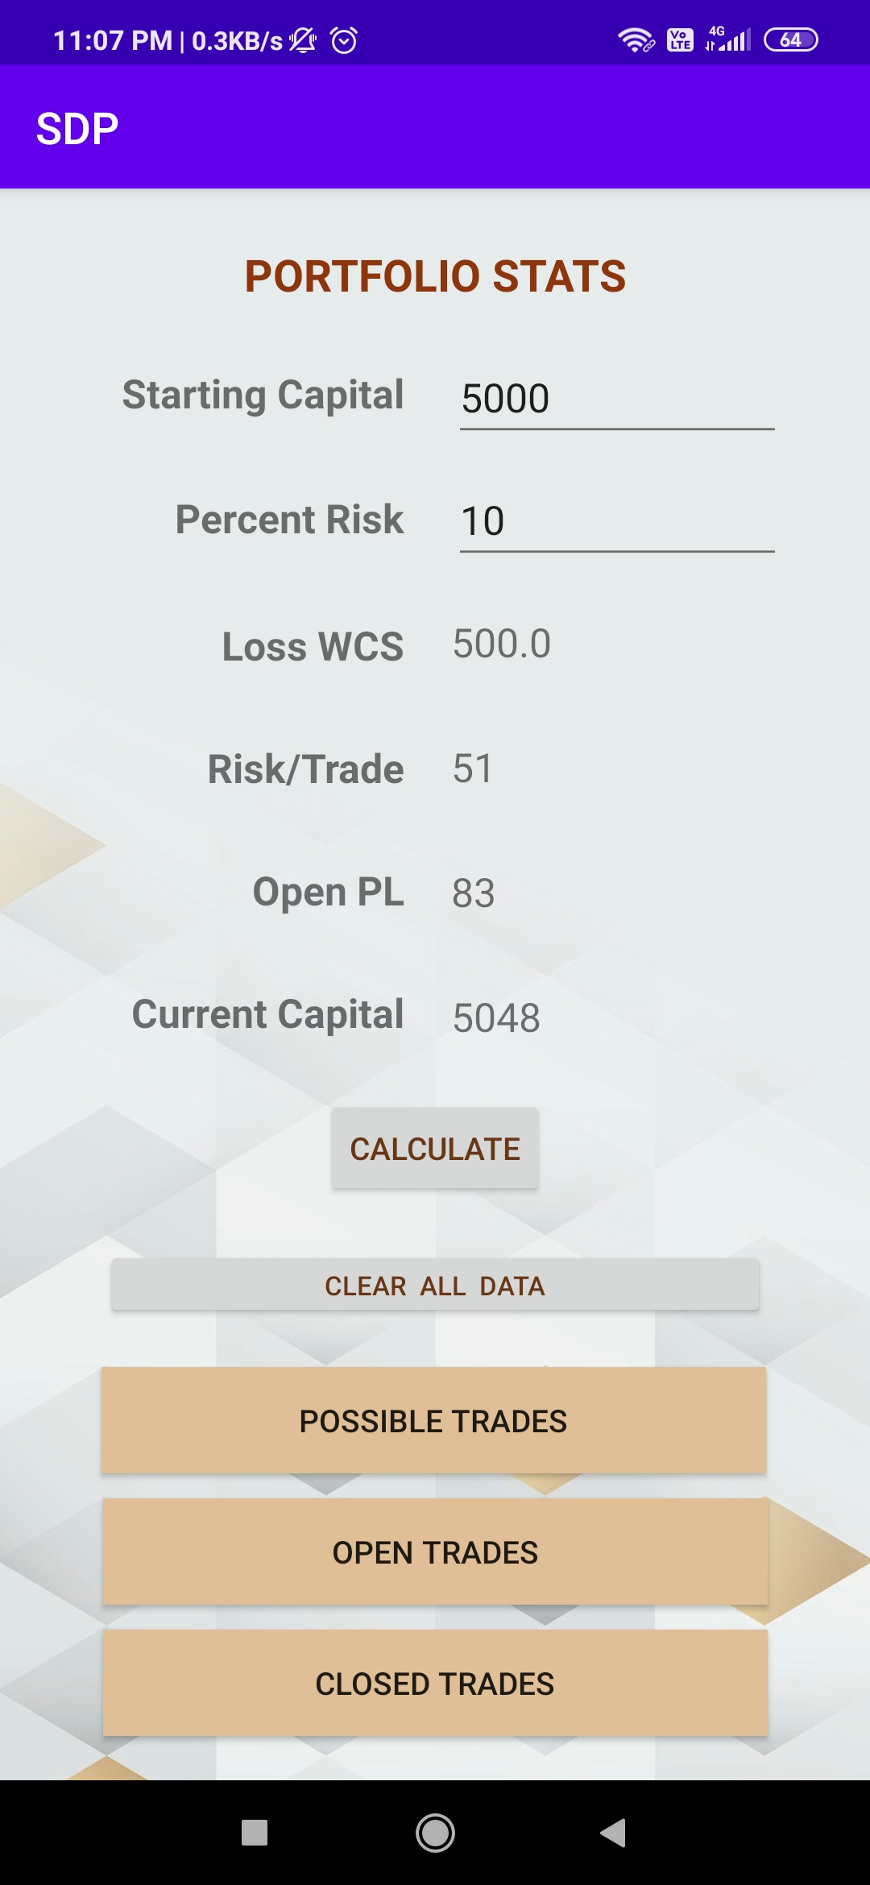
Portfolio Stats

Slide 7
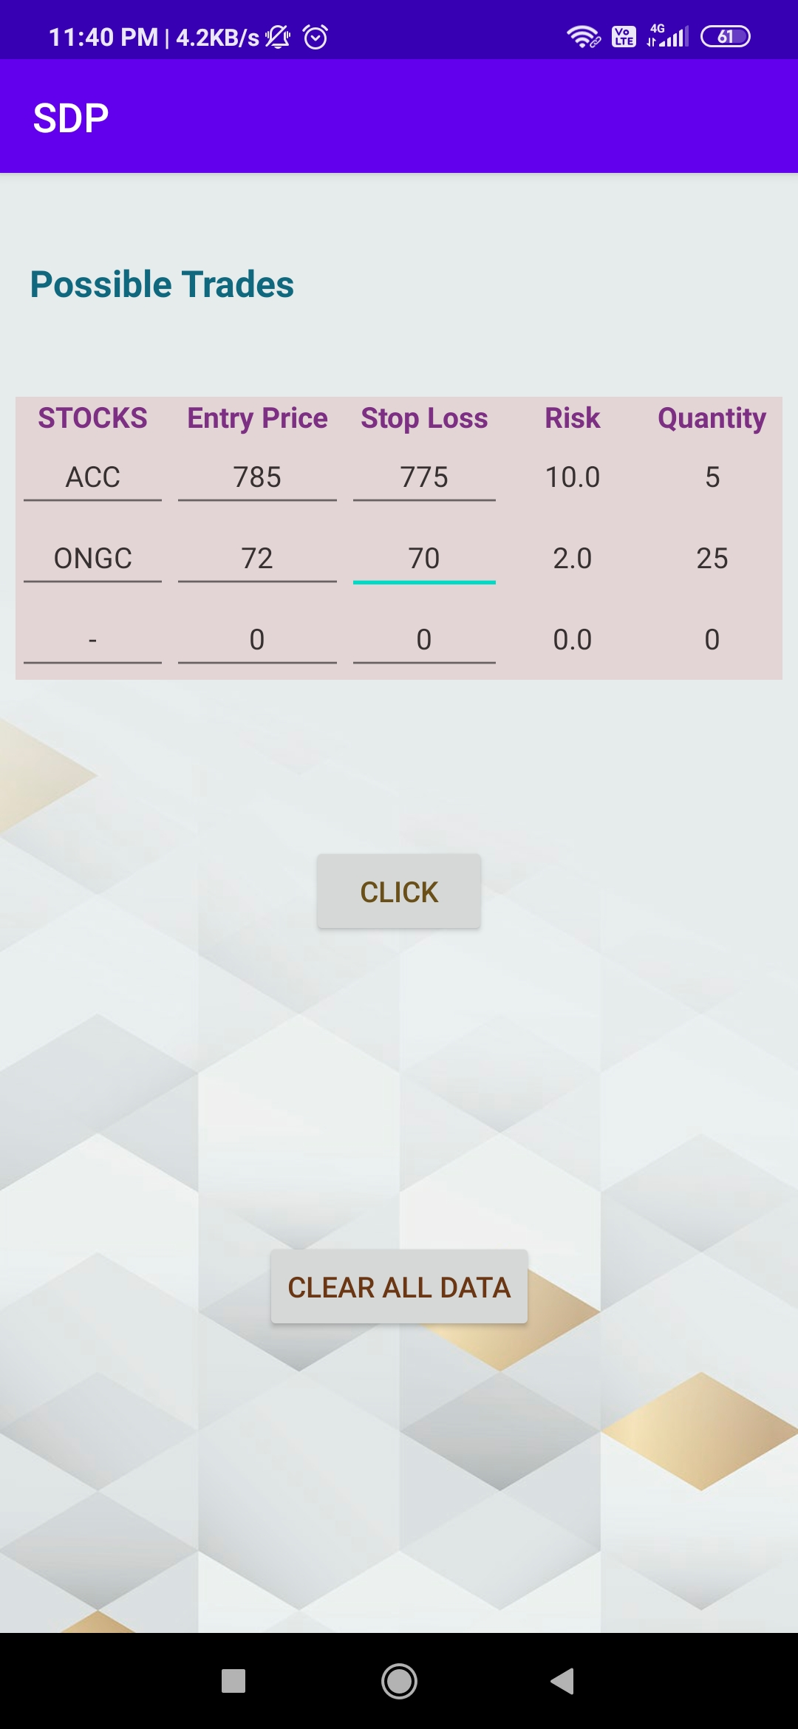
Possible Trades

Slide 8
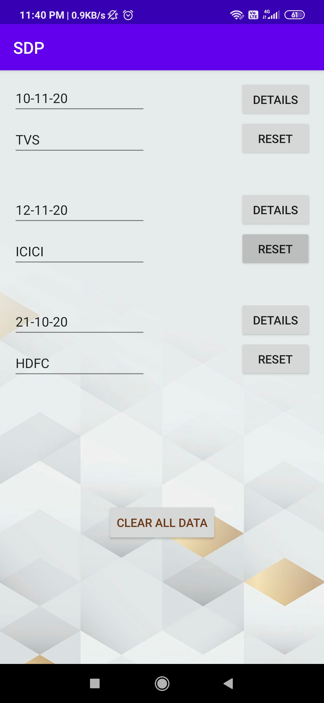
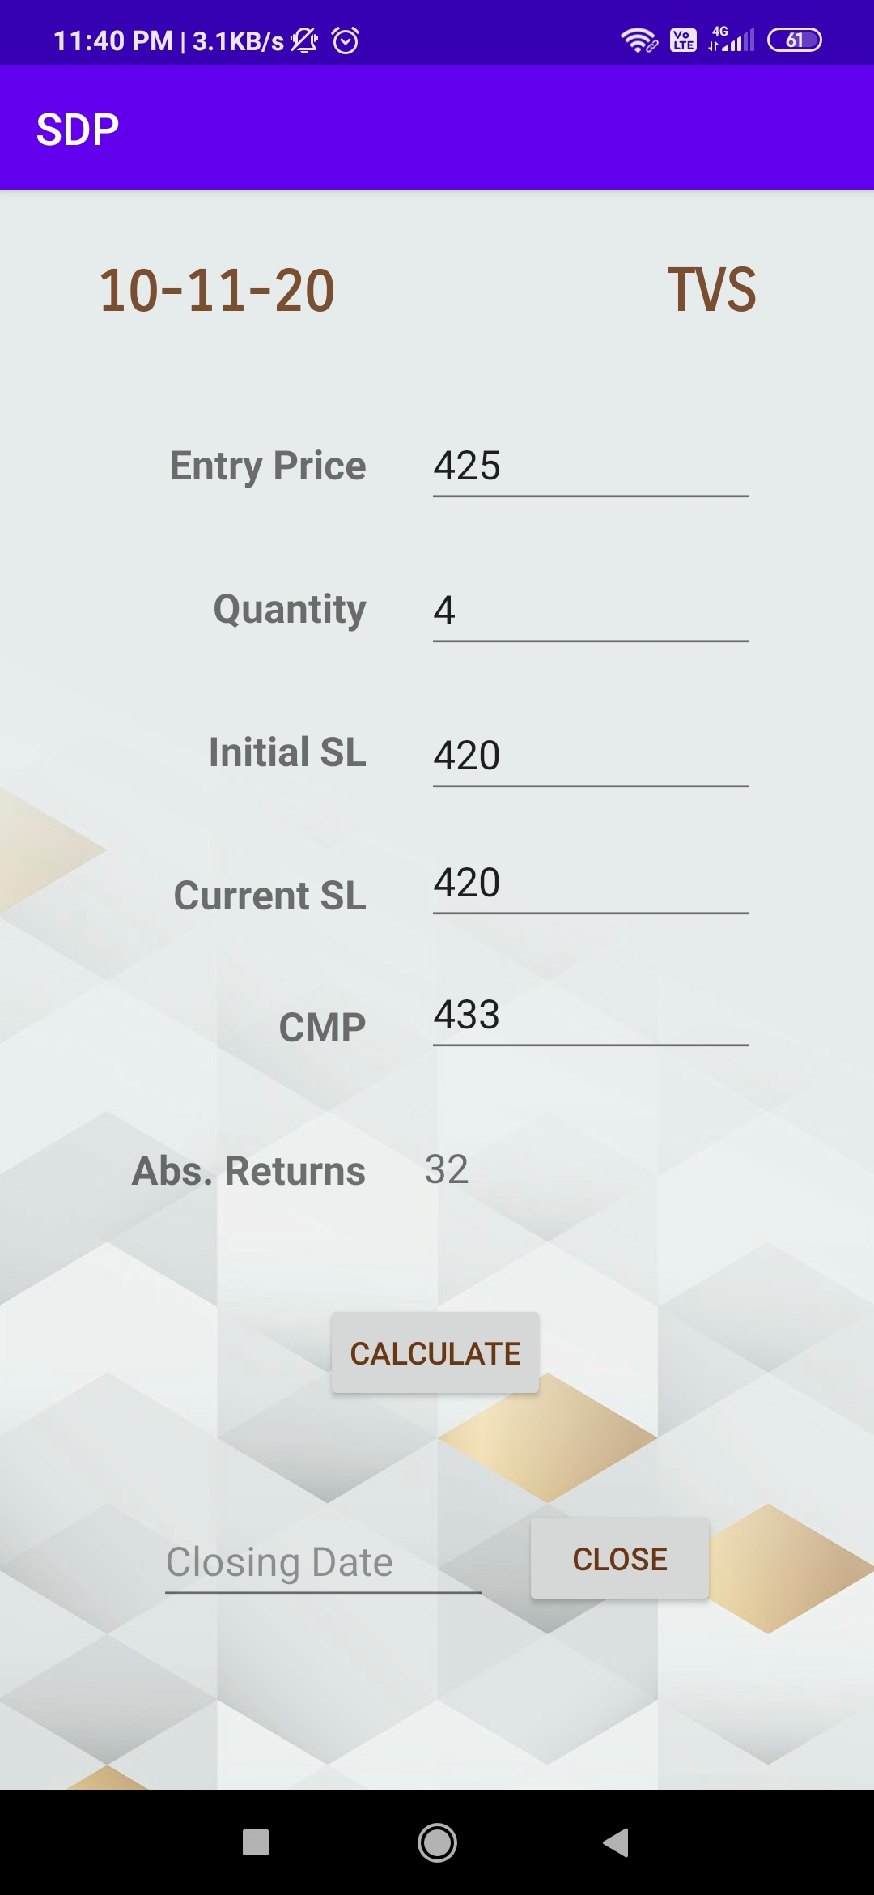
Open Trades

Slide 9
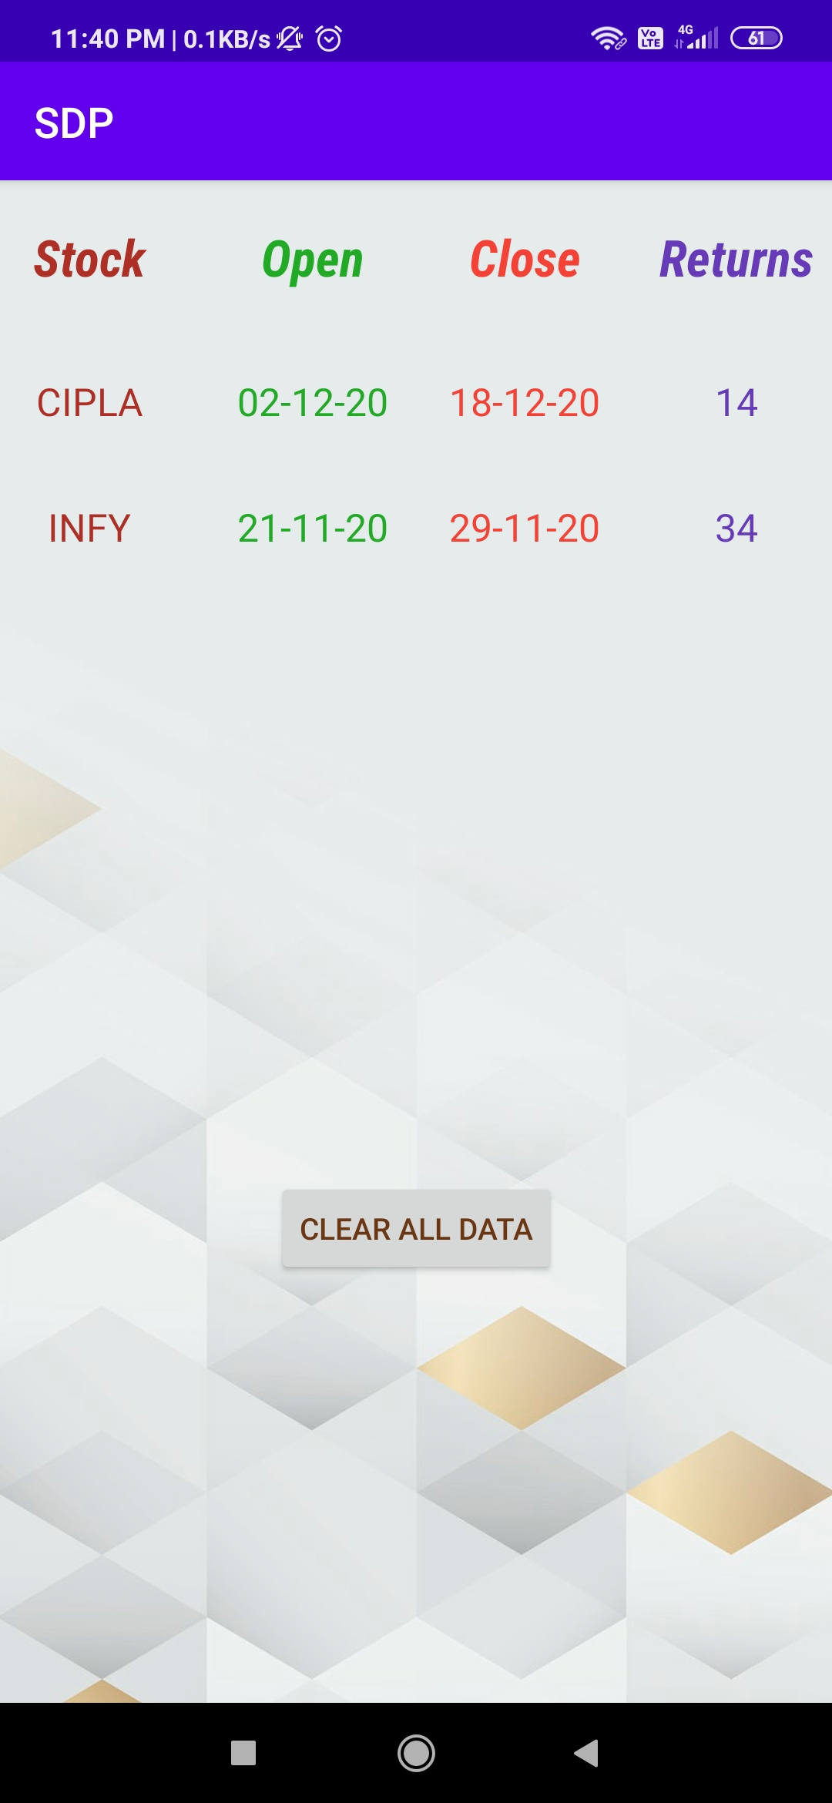
Closed Trades

Slide 10
Thank You

